Slide 1


2019
Department
Of Computer
Science
&
Electrical And
Electronics
Engineering
MATH-IV
KAS -402
2020-2021
Dr.Rupa Sharma
Associate Professor
vsrsrsys@gmail.com

Slide 2
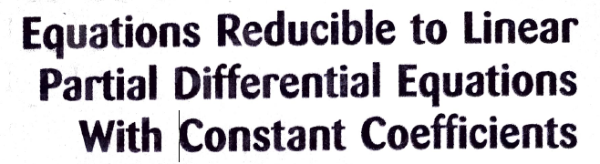

Slide 3


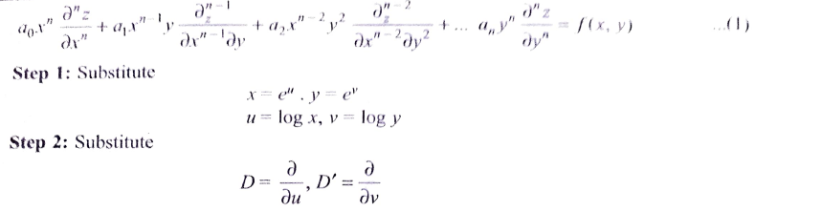

Slide 4
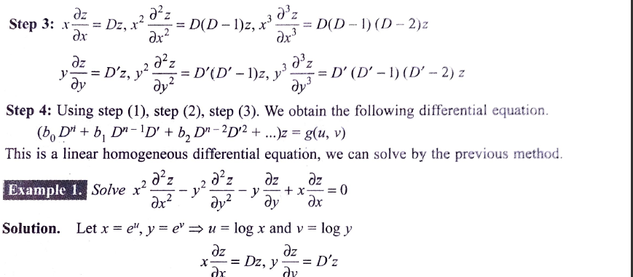

Slide 5
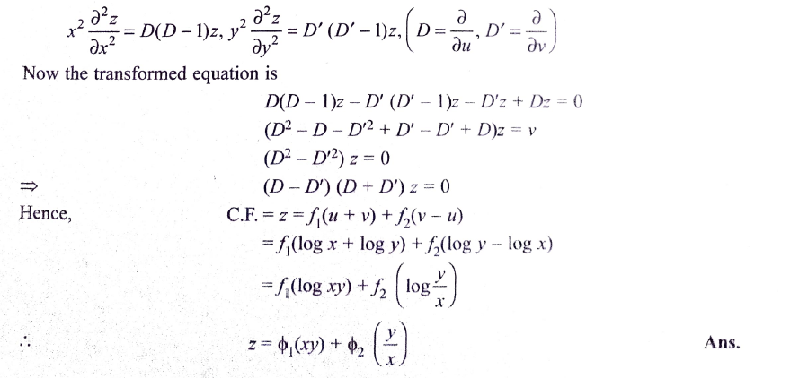

Slide 6

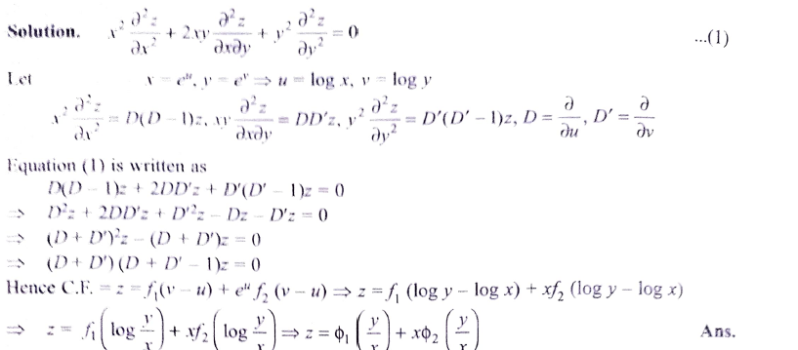

Slide 7
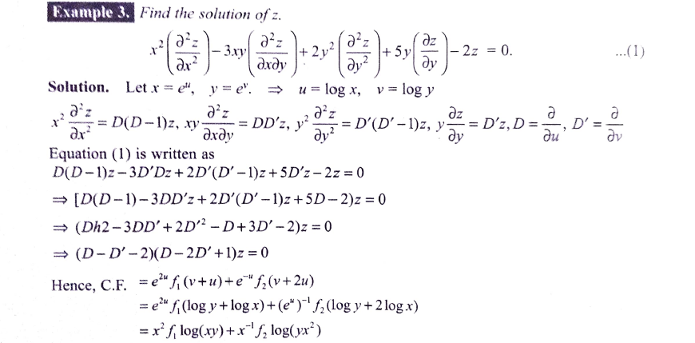


Slide 8


HOME Work
ANS:

Slide 9
THANK YOU

